Slide 1

GLP-1–Based Therapies
in Cardio-Oncology
From Cardiometabolic Risk Reduction
to Precision Survivorship
A physician scientist perspective on protecting cardiovascular reserve across the cancer continuum
A physician scientist perspective on protecting cardiovascular reserve across the cancer continuum
Dr. Sherry-Ann Brown, MD, PhD, FACC, FAHA
1
Notes:
Opening frame: position GLP-1 therapy in cardio-oncology as a cardiometabolic preservation tool, rather than a weight-loss trend. The framing should stay survivor-centered: the goal is to protect cardiovascular reserve while preserving nutrition, skeletal muscle, function, and cancer-treatment continuity.

Slide 2

Context: ESC 2022 Cardio-Oncology Guidelines frame cardiovascular health before, during, and after cancer treatment.
PERSPECTIVE
My lens: cardiometabolic preservation across survivorship
I look for the metabolic signal inside the cancer journey, then ask how that signal can become prevention, function, and equitable access.
CLINICAL INTERPRETATION
Cardio-oncology across virtual, national, and survivor-centered care settings.
RESEARCH TRANSLATION
GLP-1 biology, cardiovascular outcomes, digital health, and implementation science in one workflow.
ECOSYSTEM CAPACITY
Heart Spark ecosystem, HIER Institute, Heart Spark RII, Brown Virtual Lab, and clinical partners as a research-to-care continuum.
EQUITY COMMITMENT
Models that travel across communities, treatment settings, and data environments.
Context and source: ESC 2022 Cardio-Oncology Guidelines frame cardiovascular health before, during, and after cancer treatment.
Dr. Sherry-Ann Brown, MD, PhD, FACC, FAHA | GLP-1 Cardio-Oncology
2
Notes:
Talk track: Open with the role of physician scientist, cardio-oncologist, national virtual-care innovator, and founder of a research-to-care ecosystem. The through-line is precision prevention: identify cardiometabolic risk early enough to change the survivor trajectory. Selected source: ESC 2022 Cardio-Oncology Guidelines, which frame cardiovascular care before, during, and after cancer treatment.

Slide 3
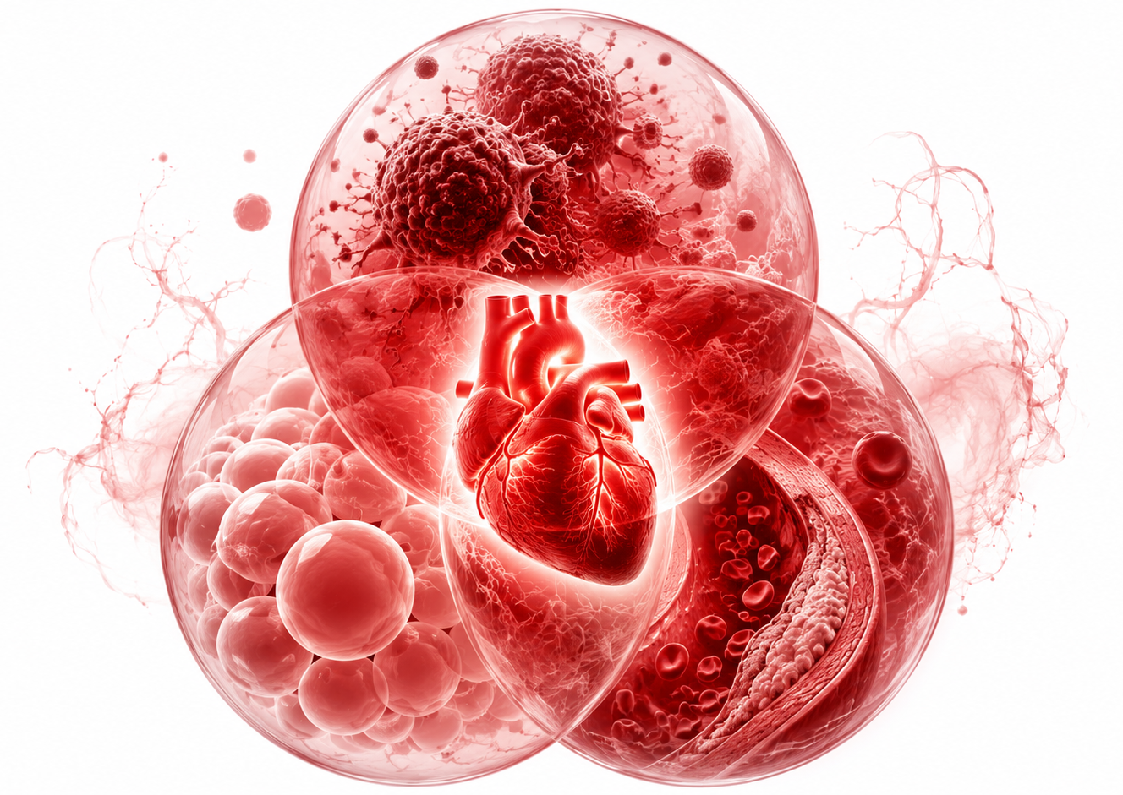
OPPORTUNITY
Why the GLP-1 interface matters now
Obesity carries cardiovascular biology.
Visceral adiposity, insulin resistance, inflammatory tone, and vascular injury shape long-term survivor risk.
Modern oncology creates longer survivorship.
As cancer outcomes improve, more patients need prevention strategies that can travel with them for decades.
GLP-1 evidence has crossed into CV outcomes.
SELECT established cardiovascular benefit in adults with CVD and overweight or obesity without diabetes; HFpEF and kidney trials expand the cardiometabolic frame.
Core thesis: incretin therapy can become cardiovascular preservation when nutrition and muscle remain protected.
Sources: Lincoff et al., NEJM 2023; Kosiborod et al., NEJM 2023; Packer et al., NEJM 2025; Perkovic et al., NEJM 2024.
Dr. Sherry-Ann Brown, MD, PhD, FACC, FAHA | GLP-1 Cardio-Oncology
3
Notes:
Talk track: This is the scientific hinge. GLP-1–based therapies now sit at the intersection of obesity medicine, cardiovascular prevention, HFpEF care, diabetes, kidney protection, and survivorship. Avoid presenting GLP-1 therapy as cancer-directed therapy. It is best framed as cardiometabolic risk reduction with oncology-specific safeguards.

Slide 4
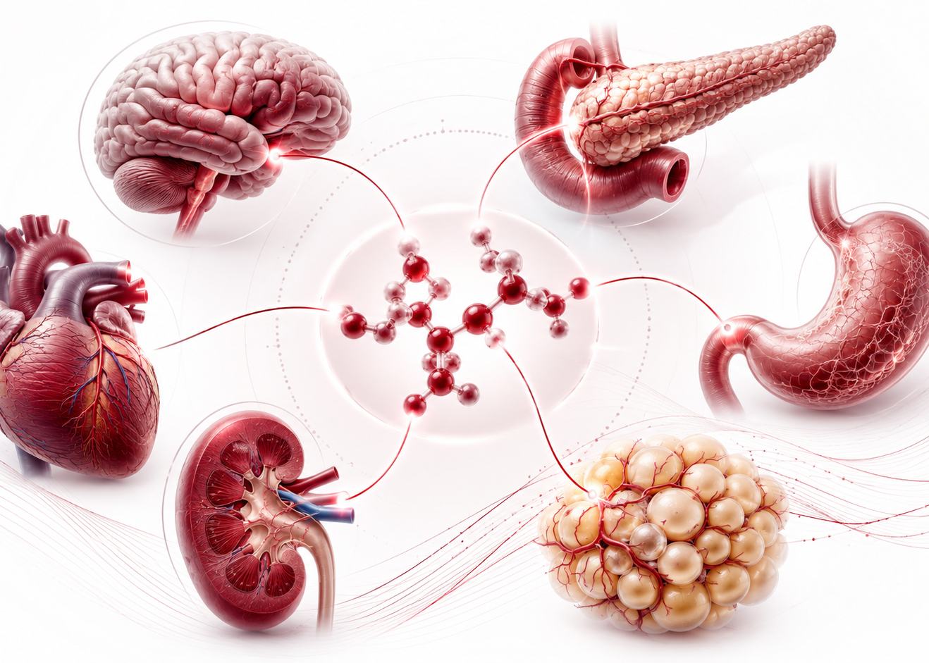
BIOLOGY
A multi-organ cardiometabolic signal
GLP-1 biology touches the systems that commonly determine cardiovascular reserve in cancer survivors.
BRAIN
PANCREAS
appetite and satiety
glucose-dependent insulin secretion
GI TRACT
ADIPOSE
gastric emptying and tolerability signal
visceral mass and inflammatory tone
KIDNEY
HEART / VESSELS
albuminuria and renal reserve
event risk through integrated risk reduction
Small physiologic shifts in several organs can become a large survivor-level change.
Sources: FDA semaglutide prescribing information; GLP-1 cardiovascular outcome literature.
Dr. Sherry-Ann Brown, MD, PhD, FACC, FAHA | GLP-1 Cardio-Oncology
4
Notes:
Talk track: GLP-1–based therapies should be introduced as multi-organ cardiometabolic therapies. Their clinical effects include glycemic improvement, appetite regulation, weight reduction, delayed gastric emptying, blood-pressure changes, and cardiovascular event reduction in selected populations. In cardio-oncology, these mechanisms matter only if function, hydration, nutritional intake, and lean mass remain protected.

Slide 5
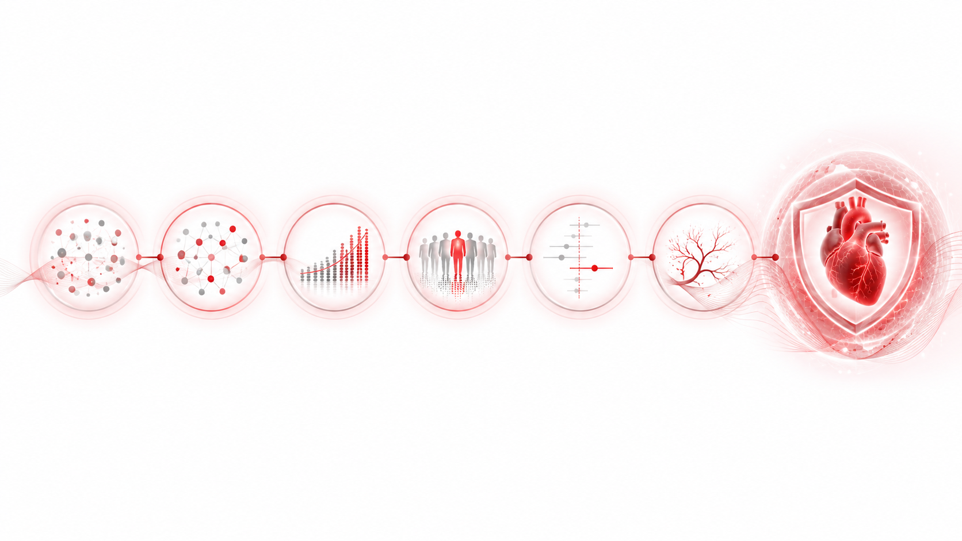
EVIDENCE
From glucose control to cardiovascular protection
1
CVOT foundation
LEADER, SUSTAIN-6, REWIND, and AMPLITUDE-O showed cardiovascular benefit in high-risk diabetes populations.
2
Obesity as a CV target
SELECT reframed obesity treatment as cardiovascular risk reduction in people with established CVD without diabetes.
3
HFpEF and function
STEP-HFpEF and SUMMIT connect incretin therapy with symptoms, function, and clinical outcomes in obesity-related HFpEF.
4
Kidney protection
FLOW supports kidney and cardiovascular outcome benefit in type 2 diabetes with chronic kidney disease.
The story moved from glucose control to cardiometabolic protection.
Sources: LEADER; SUSTAIN-6; REWIND; SELECT; STEP-HFpEF; SUMMIT; FLOW.
Dr. Sherry-Ann Brown, MD, PhD, FACC, FAHA | GLP-1 Cardio-Oncology
5
Notes:
Talk track: The evidence arc is important. Early cardiovascular outcome trials established safety and benefit in type 2 diabetes. SELECT expanded the role into obesity and established cardiovascular disease without diabetes. STEP-HFpEF and SUMMIT moved the field into obesity-related HFpEF, and FLOW extended the kidney-protection story in diabetes with CKD. The oncology connection is translational, not yet fully proven by oncology-specific randomized trials.

Slide 6

CARDIO-ONCOLOGY
Where I would start
The first clinical homes should be survivor populations where metabolic risk is visible, durable, and modifiable.
1
Breast cancer survivorship
endocrine-therapy metabolic drift, hypertension, diabetes risk, and HFpEF phenotype.
2
Prostate cancer on ADT
adiposity, insulin resistance, dyslipidemia, and muscle preservation needs.
3
HFpEF after cancer therapy
obesity-related symptoms, functional limitation, and long-term cardiovascular reserve.
4
Diabetes, CKD, and ASCVD risk
when a clear cardiometabolic indication exists and nutrition is stable.
Prescriber enthusiasm must move at the pace of the patient's physiology.
Sources: ESC 2022 Cardio-Oncology Guidelines; ASCO obesity and cancer survivorship resources; GLP-1 cardiovascular outcome trials.
Dr. Sherry-Ann Brown, MD, PhD, FACC, FAHA | GLP-1 Cardio-Oncology
6
Notes:
Talk track: Start where the cardiometabolic indication is strong and the safety profile can be monitored. Endocrine therapy in breast cancer and androgen deprivation therapy in prostate cancer are practical examples because they often create long-term cardiometabolic drift. HFpEF, diabetes, CKD, and ASCVD risk create additional entry points. Every use case requires oncology context and nutrition screening.

Slide 7

SAFETY
The guardrail is muscle
Delay initiation or escalation when the clinical signal is:
poor oral intake
unintentional weight loss
cachexia
sarcopenia or frailty
persistent nausea or vomiting
dehydration or orthostasis
Never trade skeletal muscle for a lower number on the scale.
Sources: Oncology nutrition principles; FDA semaglutide prescribing information; GLP-1 safety literature.
Dr. Sherry-Ann Brown, MD, PhD, FACC, FAHA | GLP-1 Cardio-Oncology
7
Notes:
Talk track: This slide is the clinical safeguard. In oncology, weight loss can mean fat loss, muscle loss, cachexia, dehydration, or treatment toxicity. The right endpoint is preserved function and cardiovascular reserve. If appetite, hydration, strength, or treatment tolerance decline, slow down, hold, reduce, or stop therapy and involve nutrition early.

Slide 8

PERIPROCEDURAL
Procedures require a shared plan
RISK SIGNALS
nausea, vomiting, early satiety, severe constipation, delayed gastric emptying, recent escalation, or high-dose therapy.
TEAM DISCUSSION
prescriber, oncologist, proceduralist, anesthesiologist, patient, and nutrition team when intake is fragile.
PRACTICAL OPTIONS
continue, hold when clinically appropriate, liquid-diet strategy, gastric ultrasound when available, or anesthesia-plan modification.
Symptom-based planning is safer than automatic rules.
Source: 2024 multi-society clinical practice guidance for perioperative GLP-1RA management.
Dr. Sherry-Ann Brown, MD, PhD, FACC, FAHA | GLP-1 Cardio-Oncology
8
Notes:
Talk track: Oncology patients often undergo biopsies, ports, endoscopy, surgery, and sedated imaging. GLP-1–based therapy delays gastric emptying and can overlap with cancer-treatment gastrointestinal symptoms. Current multisociety guidance emphasizes individualized risk assessment and shared decision-making, rather than one universal rule for every patient.

Slide 9

PATHWAY
From prescribing to prevention
1
Retrospective learning
cancer therapy, weight history, ECG, echo, labs, medications, symptoms, and outcomes.
2
Prospective implementation
risk tiering, nutrition screen, shared decision-making, slow titration, and follow-up cadence.
3
Continuous learning
registry review, equity monitoring, adverse-event surveillance, protocol updates, and clinician feedback.
The product is not a prescription. The product is a safer survivor pathway.
Implementation lens: cardio-oncology care pathways, learning health systems, registry science, and multidisciplinary governance.
Dr. Sherry-Ann Brown, MD, PhD, FACC, FAHA | GLP-1 Cardio-Oncology
9
Notes:
Talk track: This mirrors the implementation sequence: learn from existing data, launch carefully in selected populations, and create a continuous feedback loop. A successful GLP-1 cardio-oncology program should track not just body weight, but nutrition, function, treatment continuity, blood pressure, glycemia, kidney function, symptoms, adverse effects, equity, and outcomes.

Slide 10

FUTURE
Precision survivorship is the destination
In the future, GLP-1 decisions will be informed by:
BODY COMPOSITION
ELECTROCARDIOGRAPHY
lean mass, visceral fat, frailty
rhythm, conduction, AI-derived risk
IMAGING
BIOMARKERS
echo, strain, CT-derived phenotype
glycemia, inflammation, kidney reserve
ONCOLOGY EXPOSURE
PATIENT PRIORITIES
therapy, radiation, endocrine trajectory
function, tolerance, access, values
The best cardio-oncology programs will preserve the heart, protect strength, and extend healthy survivorship.
Future direction: multimodal precision cardio-oncology, AI-enabled risk stratification, and implementation science.
Dr. Sherry-Ann Brown, MD, PhD, FACC, FAHA | GLP-1 Cardio-Oncology
10
Notes:
Talk track: Close by looking forward. GLP-1 therapy is one component of a larger precision survivorship model. The future integrates body composition, ECG, echo, biomarkers, oncology exposure, digital health, patient priorities, and AI-enabled risk models. The final emphasis: protect the heart without compromising strength, nutrition, or cancer care.

