Slide 1

Weight Regain After GLP-1 Discontinuation
CLINICAL RISK & COST BRIEFING
What the evidence shows when patients stop semaglutide and tirzepatide — and why it matters for coverage, underwriting, and claims.
Prepared for insurance adjusters | July 2026

Slide 2
The Bottom Line Up Front
EXECUTIVE SUMMARY
~2/3
82%
$1,000+
of lost weight is regained within 12 months of stopping semaglutide (STEP 1 extension)
of tirzepatide patients regained >25% of lost weight one year after withdrawal (SURMOUNT-4)
typical monthly list price per patient — a recurring, open-ended cost exposure
Why it matters
GLP-1 receptor agonists are maintenance therapy, not a cure. Stopping reliably reverses weight loss and the cardiometabolic gains that came with it. For insurers, the risk is not a one-time procedure but an indefinite treatment horizon with high discontinuation and high regain once therapy lapses.
Weight Regain After GLP-1 Discontinuation
1

Slide 3
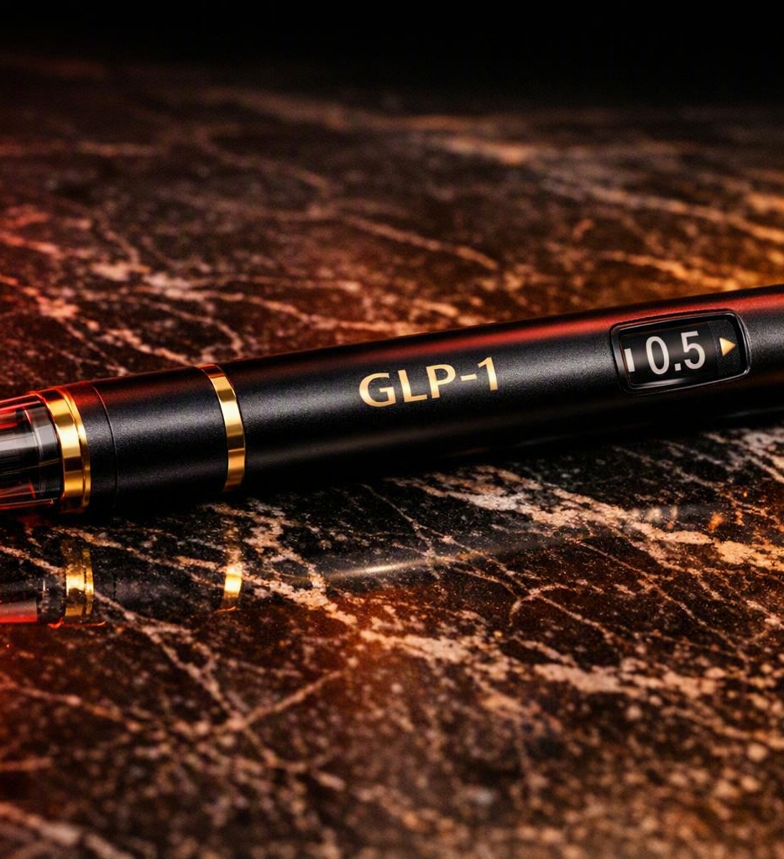
What GLP-1 Medications Are
BACKGROUND
GLP-1 receptor agonists mimic a gut hormone that curbs appetite and slows gastric emptying, producing 15–21% average weight loss in trials.
Semaglutide
Wegovy (obesity) · Ozempic (type 2 diabetes)
Tirzepatide
Zepbound (obesity) · Mounjaro (type 2 diabetes)
How dosed
Weekly self-injection, titrated up over months
Framing
Chronic-disease therapy — benefit persists only while taken
Weight Regain After GLP-1 Discontinuation
2

Slide 4

Obesity Behaves Like a Chronic Disease
THE CORE PRINCIPLE
The body defends its higher weight. When the drug clears, appetite-regulating signals return to baseline — hunger rises, satiety falls, and weight climbs back.
Not a cure
Medication controls a chronic condition; it does not permanently reset physiology.
Benefit is dose-dependent
Weight, appetite, and metabolic markers track the presence of active drug.
Stopping = relapse
Discontinuation behaves like stopping any maintenance therapy — the condition returns.
Weight Regain After GLP-1 Discontinuation
3

Slide 5
Three Pivotal Withdrawal Trials
THE EVIDENCE BASE
STEP 1 extension
STEP 4
SURMOUNT-4
Semaglutide 2.4 mg
Semaglutide 2.4 mg
Tirzepatide 10/15 mg
After stopping, participants regained about two-thirds of lost weight within one year.
Withdrawal-to-placebo arm regained 6.9% while continued treatment lost a further 7.9%.
Placebo switch regained 14% of body weight; continued treatment kept losing.
Wilding et al., Diabetes Obes Metab 2022
Rubino et al., JAMA 2021
Aronne et al., JAMA 2024
Weight Regain After GLP-1 Discontinuation
4

Slide 6
STEP 1 Extension: The Two-Thirds Rebound
SEMAGLUTIDE · WILDING 2022
17%
What happened after treatment stopped
A 52-week off-treatment extension followed participants after the core trial.
One year after the last dose, net weight retained from baseline was only about 5.6%.
Cardiometabolic improvements — blood pressure, lipids, HbA1c — also reverted toward baseline.
Greater initial loss was associated with faster, larger regain.
Mean weight lost during the 68-week core trial on semaglutide 2.4 mg
~2/3
Of that loss regained within 1 year of stopping the drug
Weight Regain After GLP-1 Discontinuation
5

Slide 7
STEP 4: Continued vs. Withdrawn
SEMAGLUTIDE · RUBINO 2021 · N=803
After a 20-week run-in (≈10.6% lost), patients were randomized to continue semaglutide or switch to placebo for 48 weeks.
14.8 pts
Separation in body weight between the two arms after 48 weeks
The gap is the measurable cost of discontinuation — the benefit reverses as soon as therapy stops.
Weight Regain After GLP-1 Discontinuation
6

Slide 8
SURMOUNT-4: Tirzepatide Withdrawal
TIRZEPATIDE · ARONNE 2024 · N=670
A 36-week open-label lead-in produced a mean 20.9% weight loss. Patients were then randomized for 52 weeks to continue tirzepatide or switch to placebo.
20.9%
Mean weight loss achieved during the 36-week lead-in phase
Continued treatment kept building results; withdrawal erased most of the lead-in gains within a year.
Weight Regain After GLP-1 Discontinuation
7

Slide 9
Most Regain Was Substantial
SURMOUNT-4 POST HOC · JAMA INTERN MED 2025
Among 308 patients switched to placebo, the amount of prior weight loss regained after one year off tirzepatide:
82%
Regained more than a quarter of their lost weight in one year
1 in 4
Regained 75% or more — nearly all the way back
Weight Regain After GLP-1 Discontinuation
8

Slide 10

The Cardiometabolic Gains Reverse Too
BEYOND THE SCALE
Withdrawal doesn't just add weight back — it undoes the health improvements insurers care about most.
Blood pressure
Systolic and diastolic pressures drift back up as weight returns.
Lipids
Improvements in cholesterol and triglycerides partially reverse.
Glucose control
HbA1c and fasting glucose climb toward pre-treatment levels.
Emerging data link GLP-1 discontinuation with higher cardiovascular event risk in diabetes.
Waist & body composition
Central adiposity re-accumulates alongside overall weight.
Weight Regain After GLP-1 Discontinuation
9

Slide 11
Why the Weight Comes Back
MECHANISM
1
2
3
4
Drug clears
Appetite returns
Intake rises
Weight rebounds
Weekly injections stop; active drug washes out of the system within weeks.
GLP-1 signaling fades — hunger increases and satiety after meals declines.
Caloric intake creeps up while the body defends its previous higher set point.
Body weight and metabolic markers track back toward pre-treatment levels.
The takeaway: regain is physiological, not a failure of willpower. Tapering and structured lifestyle support can slow it, but rarely prevent it entirely.
Weight Regain After GLP-1 Discontinuation
10

Slide 12
Discontinuation Is the Norm, Not the Exception
REAL-WORLD PERSISTENCE
~50%
Why persistence matters to insurers
Real-world persistence is far lower than in the controlled trials that generate the headline weight-loss numbers.
Stop-start cycling is common — each lapse risks regain and repeated re-titration costs.
Weight regain after a covered course can lead to renewed claims, comorbidity care, and repeat prescriptions.
Coverage decisions should anticipate a long, intermittent treatment relationship rather than a finite course.
of patients discontinue GLP-1 therapy within the first year — even when cost is not the barrier
Multi-factor
drivers: side effects, cost, access, plateaus, and perceived 'done' after weight loss
Weight Regain After GLP-1 Discontinuation
11

Slide 13

The Cost Exposure Is Recurring
ECONOMICS
$13k–$16k+
Indefinite
$0–$50 / fill
annualized list cost per patient, per year of therapy
duration — maintenance is ongoing, not a one-time course
possible with coverage plus savings cards, shifting cost to the plan
Weight Regain After GLP-1 Discontinuation
12

Slide 14
Implications for Coverage & Claims
FOR INSURANCE ADJUSTERS
Underwriting horizon
Documented regain risk
Coverage-continuity trade-off
Treat GLP-1 therapy as chronic and open-ended — not a short course with a fixed end date.
Any lapse in coverage predictably leads to weight and comorbidity rebound; factor this into risk models.
Denying or interrupting refills can trigger regain and downstream costs that exceed the drug spend.
Prior auth & step therapy
Maintenance-dose pathways
Whole-cost view
Common gatekeeping tools; weigh their savings against relapse risk when therapy is stopped.
Lower maintenance dosing may retain benefit at reduced cost — relevant to formulary design.
Model drug cost against avoided cardiometabolic claims, not in isolation.
Weight Regain After GLP-1 Discontinuation
13

Slide 15
What Reduces Regain Risk
MITIGATION STRATEGIES
Evidence-informed levers that can slow regain and protect the value of a covered course of therapy:
Gradual tapering
Stepping the dose down rather than stopping abruptly may blunt the rebound in appetite and weight.
Maintenance dosing
Continued low-dose therapy preserves much of the benefit at a lower ongoing cost.
Structured lifestyle support
Protein-forward nutrition, resistance training, and behavioral follow-up support weight maintenance.
Continuity of coverage
Avoiding abrupt coverage gaps prevents the stop-start cycles that drive relapse and repeat costs.
Realistic expectations
Framing therapy as long-term from the outset improves persistence and adherence.
Weight Regain After GLP-1 Discontinuation
14

Slide 16
Key Takeaways for Adjusters
SUMMARY
Regain is the default
Roughly two-thirds of lost weight returns within a year of stopping; most tirzepatide patients regain over 25%.
1
Health benefits reverse
Blood pressure, lipids, and glucose control revert — raising downstream comorbidity and event risk.
2
Discontinuation is common
About half of patients stop within a year, making stop-start cycling and repeat costs likely.
3
Cost is recurring
At $1,000+ per month indefinitely, this is an ongoing exposure — not a one-time expense.
4
Continuity may be cheaper
Interrupting therapy can trigger regain whose downstream costs exceed the drug spend itself.
5
Weight Regain After GLP-1 Discontinuation
15

Slide 17
Sources
REFERENCES
Wilding JPH, et al. Weight regain and cardiometabolic effects after withdrawal of semaglutide: the STEP 1 trial extension. Diabetes Obes Metab. 2022;24(8):1553–1564.
Rubino D, et al. Effect of continued weekly subcutaneous semaglutide vs placebo on weight loss maintenance (STEP 4). JAMA. 2021;325(14):1414–1425.
Aronne LJ, et al. Continued treatment with tirzepatide for maintenance of weight reduction (SURMOUNT-4). JAMA. 2024;331(1):38–48.
Horn DB, et al. Cardiometabolic parameter change by weight regain on tirzepatide withdrawal: post hoc analysis of SURMOUNT-4. JAMA Intern Med. 2025.
Khan SS, Ndumele CE, Kazi DS. Discontinuation of glucagon-like peptide-1 receptor agonists. JAMA. 2025;333(2):113–114.
Xie Y, Choi T, Al-Aly Z. GLP-1 receptor agonist discontinuation and risk of major adverse cardiovascular events. BMJ Med. 2026.
Manufacturer list-price and coverage data, 2026 (Wegovy, Zepbound); real-world persistence and cost analyses.
Prepared July 2026 · Clinical figures cited from peer-reviewed trials; cost figures are indicative list prices.
Weight Regain After GLP-1 Discontinuation
16

