Slide 1

GLP-1 Receptor Agonists
EVIDENCE BRIEFING · FOR INSURANCE & CLAIMS PROFESSIONALS
Myths, Misconceptions & Media Headlines
Separating clinical evidence from hype — and what the difference means for underwriting and claims.

Slide 2
A quiet drug boom is reshaping risk
WHY THIS LANDS ON YOUR DESK
GLP-1 therapies moved from a diabetes niche to a mass phenomenon in five years — fast enough to outrun the models underwriters and adjusters rely on.
5×
~1 in 3
5.8% → 15.3%
Growth in GLP-1 prescriptions across U.S. adults since 2020, with the fastest uptake at ages 50–69.
2025 users in a large applicant cohort had no diabetes code — increasingly a weight-loss population.
Rise in life-insurance “mortality slippage” since 2019 — roughly one in six policies now mispriced.
GLP-1 EVIDENCE BRIEFING · MYTHS, MISCONCEPTIONS & MEDIA HEADLINES
02

Slide 3
What a GLP-1 actually is
THE BASICS, BRIEFLY
GLP-1 is a gut hormone your body already makes after eating — clinicians call it the body’s “food thermostat.” These drugs mimic it.
01
Signals fullness Tells the brain you’ve eaten, curbing appetite and how much food feels “enough.”
02
Slows digestion Delays gastric emptying, so meals satisfy longer and blood sugar rises more gently.
03
Steadies blood sugar Prompts insulin when glucose is high — the original type-2 diabetes purpose.
04
Reaches beyond weight GLP-1 receptors also sit in the heart, kidney, liver and brain — the basis for wider effects.
GLP-1 EVIDENCE BRIEFING · MYTHS, MISCONCEPTIONS & MEDIA HEADLINES
03

Slide 4
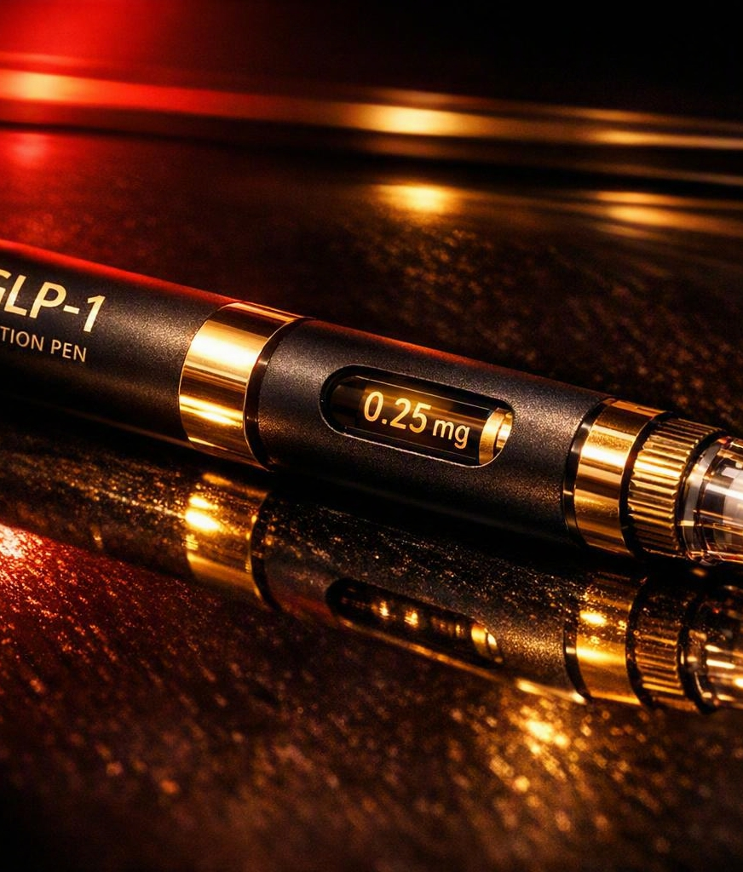
Four brands, two molecules, two makers
KNOW THE NAMES
The brand name signals the FDA-approved use — not a different drug. Confusing them is the most common myth of all.
Semaglutide Novo Nordisk
Ozempic — type-2 diabetes (2017)
Wegovy — weight management (2021)
Oral tablet added (2025)
Tirzepatide Eli Lilly · GLP-1 + GIP
Mounjaro — type-2 diabetes (2022)
Zepbound — weight management (2023)
Same molecule, different label — the chemistry doesn’t change.
GLP-1 EVIDENCE BRIEFING · MYTHS, MISCONCEPTIONS & MEDIA HEADLINES
04

Slide 5
Myth vs. Evidence
MYTH NO. 1
MYTH
WHAT THE EVIDENCE SHOWS
It is a cardiometabolic therapy with hard outcome data.
“It’s just a cosmetic weight-loss fad.”
SELECT trial (17,000+): 20% fewer heart attacks and strokes — even in people without diabetes.
Approved or evidenced for kidney disease, MASH liver disease and obstructive sleep apnea.
Weight loss of ~13–15% (semaglutide) and ~18–22% (tirzepatide) in randomized trials.
WHY IT STICKS Before-and-after headlines frame these drugs as vanity aids, not medicine.
GLP-1 EVIDENCE BRIEFING · MYTHS, MISCONCEPTIONS & MEDIA HEADLINES
05

Slide 6
Myth vs. Evidence
MYTH NO. 2
MYTH
WHAT THE EVIDENCE SHOWS
Stopping usually reverses the gains.
“The results are permanent.”
About 65% of users quit within the first year of treatment.
Most metabolic improvements reverse within roughly two years of stopping.
Adherence — not time on the drug — tracks with lower modeled mortality risk.
WHY IT STICKS Rapid, visible weight loss implies a one-time, lasting cure.
GLP-1 EVIDENCE BRIEFING · MYTHS, MISCONCEPTIONS & MEDIA HEADLINES
06

Slide 7

SIGNAL VS. NOISE
Headlines vs. the evidence
“Some findings are genuinely exciting. Others are being oversold.”
SOLID, TRIAL-BACKED
Cardiovascular events
Chronic kidney disease
MASH / fatty liver disease
Obstructive sleep apnea
PROMISING BUT UNPROVEN
Cancer prevention
Endometriosis
Addiction & alcohol use
Alzheimer’s & Parkinson’s
GLP-1 EVIDENCE BRIEFING · MYTHS, MISCONCEPTIONS & MEDIA HEADLINES
07

Slide 8

THE UNDERWRITING ANGLE
The “Mirage Effect”
On the drug, an applicant can look far healthier than their true baseline risk.
01
Metrics improve fast
BMI, HbA1c, cholesterol and blood pressure all drop while treatment continues.
02
Risk can snap back
If use stops and weight returns, high-risk status can reappear by year three of a 30-year policy.
03
Detection is hard
Many buy through direct-to-consumer telehealth, leaving little trace in medical records.
GLP-1 EVIDENCE BRIEFING · MYTHS, MISCONCEPTIONS & MEDIA HEADLINES
08

Slide 9
The cost & coverage reality
FOLLOW THE MONEY
Sticker prices, a shifting compounding market, and patchy coverage all shape who actually stays on therapy.
BRAND, CASH PRICE
COMPOUNDED
WHO PAYS
$1,000–$1,650
$99–$299
40–50%
per month
per month
of large employer plans
Wegovy ~$1,349–1,650 · Ozempic ~$970–1,000 · Zepbound ~$1,271, before insurance.
Far cheaper — but the FDA ended the shortage in Feb 2026 and sharply restricted compounding.
Up from ~25% in 2023, often with strict criteria. Medicare Part D still excludes weight-loss use.
GLP-1 EVIDENCE BRIEFING · MYTHS, MISCONCEPTIONS & MEDIA HEADLINES
09

Slide 10
The real safety profile
READING THE LABEL
Genuine risks exist — but they cluster in predictable places, and sourcing matters as much as the molecule.
Common & manageable
Watch closely
Carrier stance
GI effects — nausea leads
Higher for semaglutide (~44%) vs tirzepatide (~24–33%)
Usually eases over time
Muscle-mass loss during rapid weight drop
Rebound weight regain after stopping
Salt/acetate compounded versions carry safety flags
Prefer FDA-approved formulations
Wary of compounded products
Scrutinize telehealth-only prescriptions
GLP-1 EVIDENCE BRIEFING · MYTHS, MISCONCEPTIONS & MEDIA HEADLINES
10

Slide 11
WHAT TO CARRY INTO THE FILE
Four things worth remembering
01
Treat it as a moving target
GLP-1 use is a dynamic risk signal, not a static one — health can improve, then reverse.
02
Ask the sharper question
Probe medication-driven weight change and adherence, not just current weight.
03
Separate brand from compounded
FDA-approved and compounded sourcing carry very different evidence and oversight.
04
Expect blind spots
Direct-to-consumer telehealth leaves gaps in the records you rely on.
GLP-1 EVIDENCE BRIEFING · MYTHS, MISCONCEPTIONS & MEDIA HEADLINES
11

